Slide 1
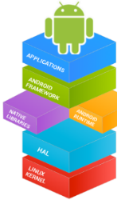



Mobile Application Development (COS7025-B) Designing Mobile Apps using Android Menus, Dialogs, and Pickers
Karim Hammoud Sadik
Lecture #5
Android Studio

Slide 2
Contents
Overview
App Bar with Options Menu
Contextual menus
Popup menus
Dialogs
Pickers

Slide 3
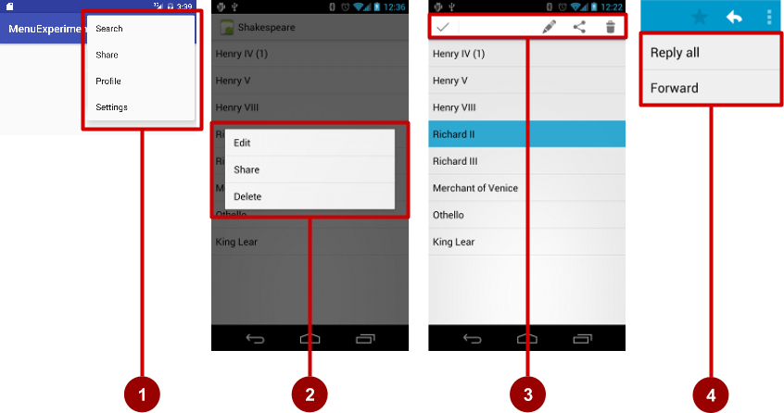
Types of Menus
App bar with options menu
Context menu
Contextual action bar
Popup menu

Slide 4
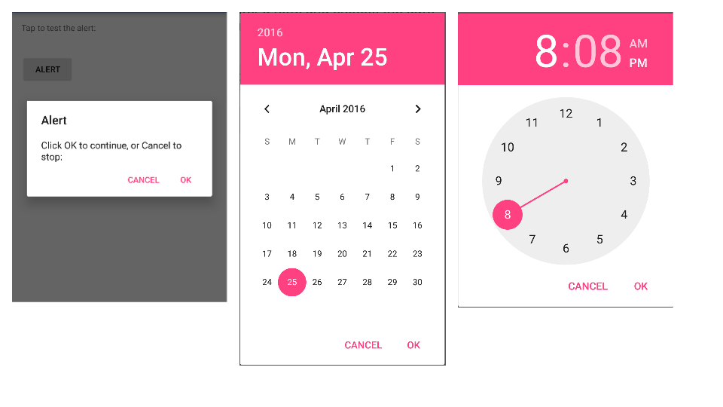
Dialogs and pickers
Alert dialog
Date picker
Time picker
1
2
3

Slide 5
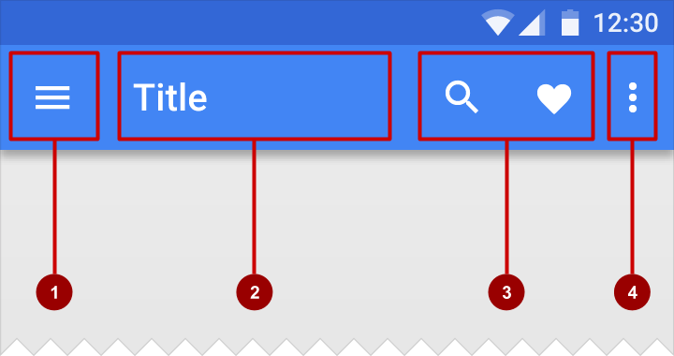
What is the App Bar?
Bar at top of each screen—same for all devices (usually)
Nav icon to open navigation drawer
Title of current Activity
Icons for options menu items
Action overflow button for the rest of the options menu

Slide 6
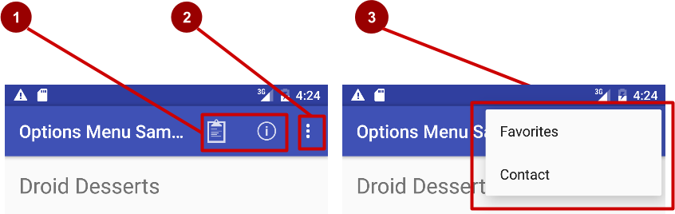
What is the options menu?
Action icons in the app bar for important items (1)
Tap the three dots, the "action overflow button" to see the options menu (2)
Appears in the right corner of the app bar (3)
For navigating to other activities and editing app settings

Slide 7
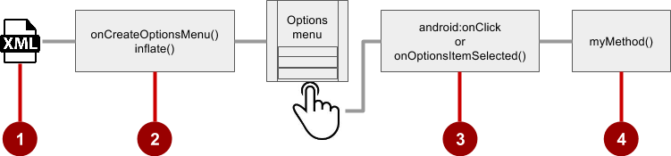
Steps to implement options menu
XML menu resource (menu_main.xml)
onCreateOptionsMenu() to inflate the menu
onClick attribute or onOptionsItemSelected()
Method to handle item click

Slide 8
Create menu resource
Create menu resource directory
Create XML menu resource (menu_main.xml)
Add entry for each menu item (Settings and Favorites):
<item android:id="@+id/option_settings"
android:title="Settings" />
<item android:id="@+id/option_favorites"
android:title="Favorites" />

Slide 9
Inflate options menu
Override onCreateOptionsMenu() in Activity
@Override
public boolean onCreateOptionsMenu(Menu menu) {
getMenuInflater().inflate(R.menu.menu_main, menu);
return true;
}

Slide 10
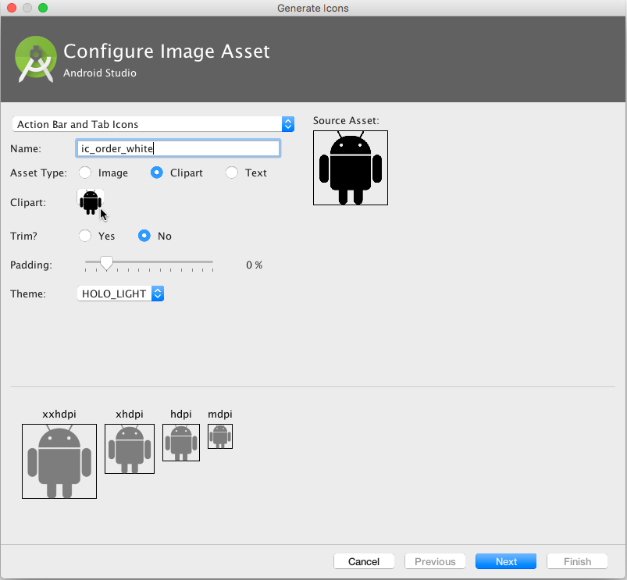
Add icons for menu items
Right-click drawable
Choose New > Image Asset
Choose Action Bar and Tab Items
Edit the icon name
Click clipart image, and click icon
Click Next, then Finish

Slide 11
Add menu item attributes
<item
android:id="@+id/action_favorites"
android:icon="@drawable/ic_favorite"
android:orderInCategory="30"
android:title="@string/action_favorites"
app:showAsAction="ifRoom" />

Slide 12
Override onOptionsItemSelected()
@Override
public boolean onOptionsItemSelected(MenuItem item) {
switch (item.getItemId()) {
case R.id.action_settings:
showSettings();
return true;
case R.id.action_favorites:
showFavorites();
return true;
default:
return super.onOptionsItemSelected(item);
}
}

Slide 13
What are contextual menus?
Allows users to perform action on selected View
Can be deployed on any View
Most often used for items in RecyclerView, GridView, or other View collection

Slide 14
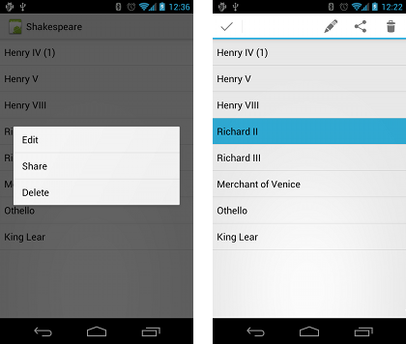
Types of contextual menus
Floating context menu—long-press on a View
User can modify View or use it in some fashion
User performs action on one View at a time
Contextual action mode—temporary action bar in place of or underneath app bar
Action items affect the selected View element(s)
User can perform action on multiple View elements at once

Slide 15
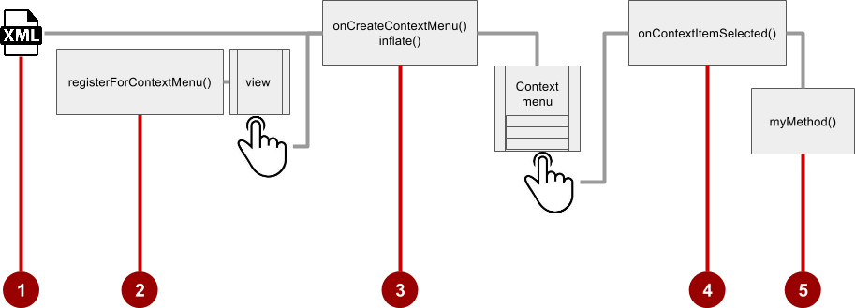
Floating Context Menu
Steps
Create XML menu resource file and assign appearance and position attributes
Register View using registerForContextMenu()
Implement onCreateContextMenu() in Activity to inflate menu
Implement onContextItemSelected() to handle menu item clicks
Create method to perform action for each context menu item

Slide 16
Create menu resource
Create XML menu resource (menu_context.xml)
<item
android:id="@+id/context_edit"
android:title="Edit"
android:orderInCategory="10"/>
<item
android:id="@+id/context_share"
android:title="Share"
android:orderInCategory="20"/>

Slide 17
Register a view to a context menu
In onCreate() of the Activity:
Register View.OnCreateContextMenuListener to View:
TextView article_text = findViewById(R.id.article);
registerForContextMenu(article_text);

Slide 18
Implement onCreateContextMenu() onCreateContextMenu() method
Specify which context menu
@Override
public void onCreateContextMenu(ContextMenu menu, View v,
ContextMenu.ContextMenuInfo menuInfo) {
super.onCreateContextMenu(menu, v, menuInfo);
MenuInflater inflater = getMenuInflater();
inflater.inflate(R.menu.menu_context, menu);
}

Slide 19
Implement onContextItemSelected() onCreateContextMenu() method
@Override
public boolean onContextItemSelected(MenuItem item) {
switch (item.getItemId()) {
case R.id.context_edit:
editNote();
return true;
case R.id.context_share:
shareNote();
return true;
default:
return super.onContextItemSelected(item);
}
}

Slide 20
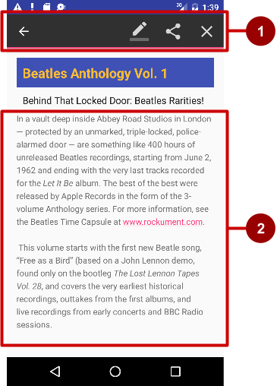
What is a contextual action bar?
Long-press on View shows contextual action bar
Contextual action bar with actions
Edit, Share, and Delete
Done (left arrow icon) on left side
Action bar is available until user taps Done
View on which long press triggers contextual action bar

Slide 21
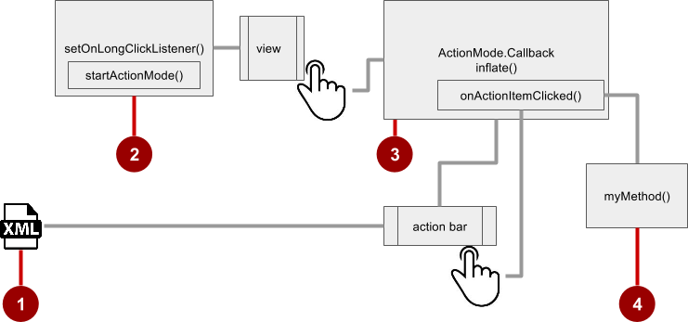
Steps for contextual action bar
Create XML menu resource file and assign icons for items
setOnLongClickListener() on View that triggers contextual action bar and call startActionMode() to handle click
Implement ActionMode.Callback interface to handle ActionMode lifecycle; include action for menu item click in onActionItemClicked() callback
Create method to perform action for each context menu item

Slide 22
Use setOnLongClickListener
private ActionMode mActionMode;
In onCreate():
View view = findViewById(article);
view.setOnLongClickListener(new View.OnLongClickListener() {
public boolean onLongClick(View view) {
if (mActionMode != null) return false;
mActionMode =
MainActivity.this.startActionMode(mActionModeCallback);
view.setSelected(true);
return true;
}
});

Slide 23
Use setOnLongClickListener
private ActionMode mActionMode;
In onCreate():
View view = findViewById(article);
view.setOnLongClickListener(new View.OnLongClickListener() {
public boolean onLongClick(View view) {
if (mActionMode != null) return false;
mActionMode =
MainActivity.this.startActionMode(mActionModeCallback);
view.setSelected(true);
return true;
}
});

Slide 24
Implement mActionModeCallback
public ActionMode.Callback mActionModeCallback =
new ActionMode.Callback() {
// Implement action mode callbacks here.
};

Slide 25
Implement onCreateActionMode
@Override
public boolean onCreateActionMode(ActionMode mode, Menu menu) {
MenuInflater inflater = mode.getMenuInflater();
inflater.inflate(R.menu.menu_context, menu);
return true;
}

Slide 26
Implement onPrepareActionMode
Called each time action mode is shown
Always called after onCreateActionMode, but may be called multiple times if action mode is invalidated
@Override
public boolean onPrepareActionMode(ActionMode mode, Menu menu) {
return false; // Return false if nothing is done.
}

Slide 27
Implement onActionItemClicked
Called when users selects an action
Handle clicks in this method
@Override
public boolean onActionItemClicked(ActionMode mode, MenuItem item) {
switch (item.getItemId()) {
case R.id.action_share:
// Perform action for the Share menu item.
mode.finish(); // Action picked, so close the action bar.
return true;
default:
return false;
}
}

Slide 28
Implement onDestroyActionMode
Called when user exits the action mode
@Override
public void onDestroyActionMode(ActionMode mode) {
mActionMode = null;
}

Slide 29
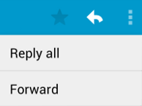
What is a popup menu?
Vertical list of items anchored to a view
Typically anchored to a visible icon
Actions should not directly affect view content
Options menu overflow icon that opens options menu
In email app, Reply All and Forward relate to email message but don’t affect or act on message

Slide 30
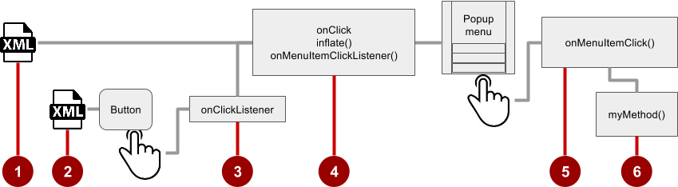
Steps
Create XML menu resource file and assign appearance and position attributes
Add ImageButton for the popup menu icon in the XML activity layout file
Assign onClickListener to ImageButton
Override onClick() to inflate the popup and register it with onMenuItemClickListener()
Implement onMenuItemClick()
Create a method to perform an action for each popup menu item

Slide 31

Add ImageButton
<ImageButton
android:layout_width="wrap_content"
android:layout_height="wrap_content"
android:id="@+id/button_popup"
android:src="@drawable/@drawable/ic_action_popup"/>

Slide 32
Assign onClickListener to button
private ImageButton mButton = (ImageButton) findViewById(R.id.button_popup);
In onCreate():
mButton.setOnClickListener(new View.OnClickListener() {
// define onClick
});

Slide 33
Implement onClick
@Override
public void onClick(View v) {
PopupMenu popup = new PopupMenu(MainActivity.this, mButton);
popup.getMenuInflater().inflate(
R.menu.menu_popup, popup.getMenu());
popup.setOnMenuItemClickListener( new PopupMenu.OnMenuItemClickListener() {
// implement click listener.
});
popup.show();
}

Slide 34
Implement onMenuItemClick
public boolean onMenuItemClick(MenuItem item) {
switch (item.getItemId()) {
case R.id.option_forward:
// Implement code for Forward button.
return true;
default:
return false;
}
}

Slide 35
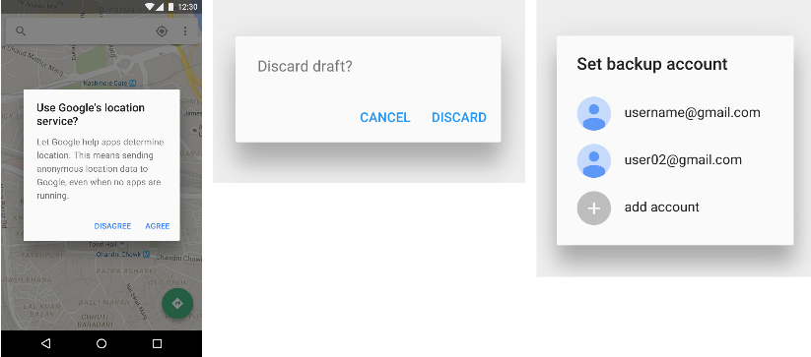
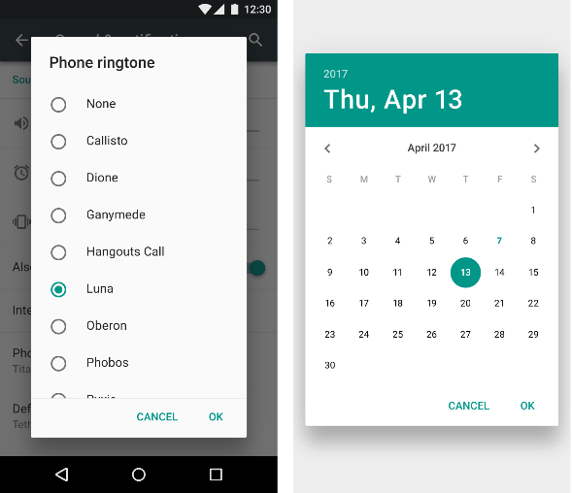
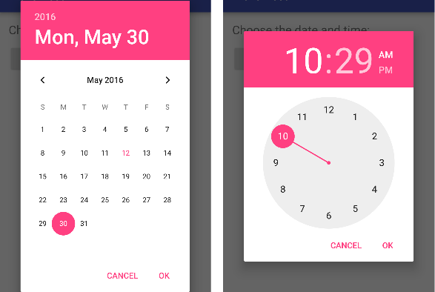
What is a Dialog?
Dialog appears on top, interrupting flow of Activity
Requires user action to dismiss
TimePickerDialog
DatePickerDialog
AlertDialog

Slide 36
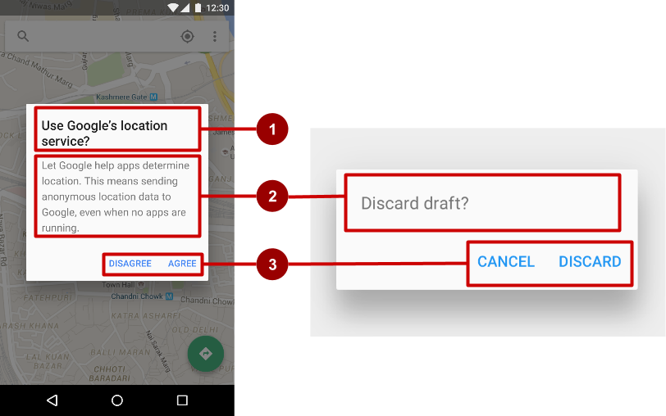
AlertDialog
AlertDialog can show:
Title (optional)
Content area
Action buttons

Slide 37
Build the AlertDialog
Use AlertDialog.Builder to build alert dialog and set attributes:
public void onClickShowAlert(View view) {
AlertDialog.Builder alertDialog = new
AlertDialog.Builder(MainActivity.this);
alertDialog.setTitle("Connect to Provider");
alertDialog.setMessage(R.string.alert_message);
// ... Code to set buttons goes here.

Slide 38
Set the button actions
alertDialog.setPositiveButton()
alertDialog.setNeutralButton()
alertDialog.setNegativeButton()

Slide 39
alertDialog code example
alertDialog.setPositiveButton(
"OK", newDialogInterface.OnClickListener() {
public void onClick(DialogInterface dialog, int which) {
// User clicked OK button.
}
});
Same pattern for setNegativeButton() and setNeutralButton()

Slide 40
What is a Picker?
DatePickerDialog
TimePickerDialog

Slide 41
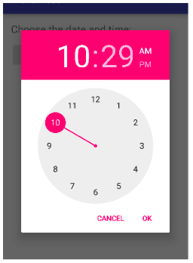
Pickers use fragments
Use DialogFragment to show a picker
DialogFragment is a window that floats on top of Activity window

Slide 42
What is a fragment?
A Fragment is like a mini-Activity within an Activity
Manages its own own lifecycle
Receives its own input events
Can be added or removed while parent Activity is running
Multiple fragments can be combined in a single Activity
Can be reused in more than one Activity
We will talk about fragment Next Week

Slide 43
Creating a date picker dialog
Add a blank Fragment that extends DialogFragment and implements DatePickerDialog.OnDateSetListener
In onCreateDialog() initialize the date and return the dialog
In onDateSet() handle the date
In Activity show the picker and add method to use date

Slide 44
Creating a time picker dialog
Add a blank Fragment that extends DialogFragment and implements TimePickerDialog.OnTimeSetListener
In onCreateDialog() initialize the time and return the dialog
In onTimeSet() handle the time
In Activity, show the picker and add method to use time

Slide 45
Any Questions?

